Slide 1
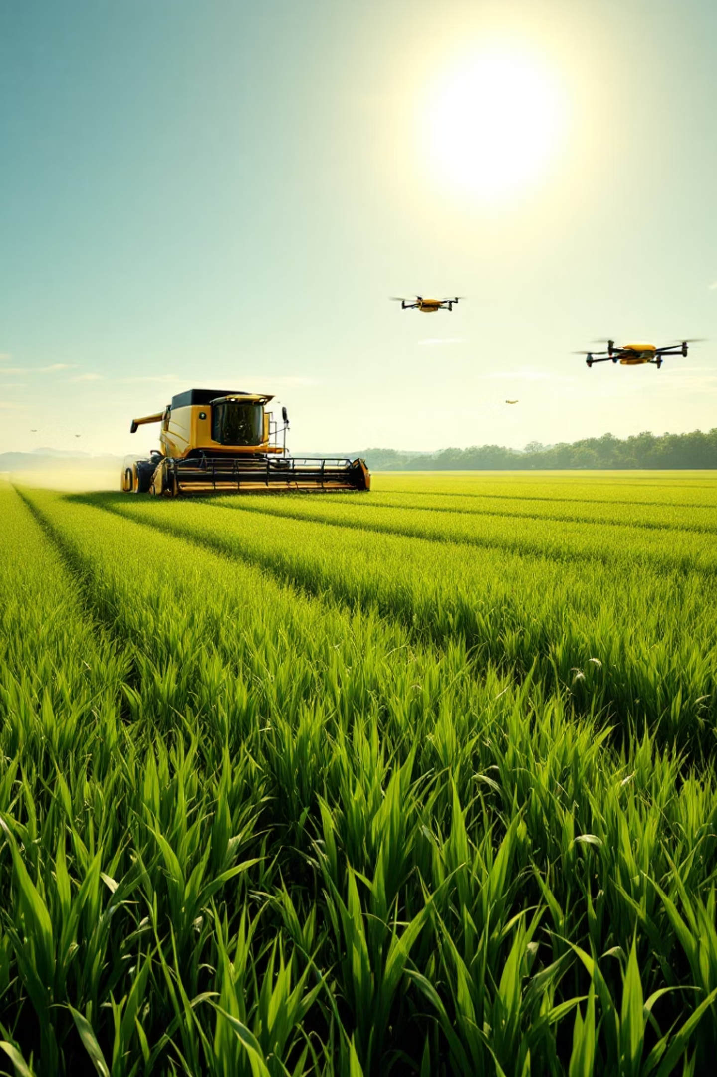
AGROBOT
Universal AI-Based Agricultural Assistant
Empowering farmers worldwide with intelligent, multilingual agricultural support through cutting-edge artificial intelligence and computer vision technology.
Nemeshvar M V
Infosys Virtual Internship 6.0
Kalasalingam Academy of Research and Education
Srivilliputhur, TamilNadu

Slide 2
Revolutionizing Agriculture with AI Intelligence
What is Agrobot?
Core Capabilities
Agrobot is a groundbreaking AI-powered agricultural assistant designed specifically for farmers who need instant, reliable guidance in the field. This comprehensive web-based platform combines advanced computer vision, natural language processing, and multilingual support to deliver immediate plant disease diagnosis and treatment recommendations.
Image-based plant disease detection using deep learning models
Advanced text-based symptom analysis and pattern matching
Voice input support through integrated Web Speech API
Comprehensive multi-language support across six Indian languages
Built on the robust Django framework, Agrobot bridges the gap between complex agricultural science and practical farming needs, making expert knowledge accessible to farmers regardless of their technical background or location.
Real-time translation and response generation
24/7 availability through web platform accessibility

Slide 3
Addressing Critical Agricultural Challenges
Disease Identification Crisis
Language Barriers
Time-Sensitive Decisions
Farmers struggle to identify plant diseases quickly and accurately, leading to inappropriate treatments and significant crop losses. Traditional identification methods rely on visual experience that takes years to develop.
Agricultural information is often available only in English, creating barriers for local farmers who are more comfortable communicating in their native languages. This limits access to critical farming knowledge.
Plant diseases spread rapidly, and delayed diagnosis can result in devastating crop losses. Farmers need immediate access to expert consultation, especially in remote areas where agricultural experts are scarce.
Our Intelligent Solution
Instant AI Detection
Multilingual Interface
Advanced computer vision provides immediate disease identification from simple smartphone photos
Native language support removes communication barriers and improves farmer confidence
24/7 Availability
Evidence-Based Recommendations
Web-based platform ensures farmers can get help whenever they need it, day or night
Treatment suggestions backed by agricultural science and proven farming practices

Slide 4
Robust Technology Foundation
Backend Technologies
Frontend & Database
Django 4.2 Framework
Modern Web Interface
Provides robust web application structure with built-in security features, ORM capabilities, and scalable architecture for handling multiple concurrent users.
Bootstrap 5, HTML5, and CSS3 create responsive, mobile-friendly designs that work seamlessly across all devices and screen sizes.
Interactive Features
AI/ML Integration
Web Speech API and Fetch API enable voice input, real-time communication, and dynamic content updates without page refreshes.
TensorFlow and ONNX Runtime deliver optimized machine learning inference, while OpenCV and PIL handle advanced image processing for accurate disease detection.
Efficient Data Management
SQLite database with Django ORM provides fast, reliable storage for symptom data, treatment recommendations, and user interactions.
Natural Language Processing
Google Translate API and language detection algorithms enable seamless multilingual communication and context understanding.

Slide 5






Intelligent System Architecture
Web Interface Layer
Disease Detection Engine
Symptom Matching System
Responsive user interaction layer that handles image uploads, text input, and voice commands through an intuitive chat-like interface designed for farmers of all technical backgrounds.
Advanced ONNX model processes uploaded images through convolutional neural networks, analyzing visual patterns to identify plant diseases with high accuracy and confidence scores.
Sophisticated text analysis engine uses fuzzy string matching and natural language processing to correlate user descriptions with known disease symptoms and patterns.
Translation Service
Database Layer
Multilingual processing pipeline automatically detects input language, translates for analysis, and converts responses back to the user's preferred language while maintaining context.
Comprehensive storage system managing symptom databases, treatment protocols, and user interactions with efficient querying and data retrieval capabilities.
Data Flow Process: Input (Image/Text/Voice) → Processing → ML Analysis → Database Lookup → Response Generation → Translation → Output

Slide 6
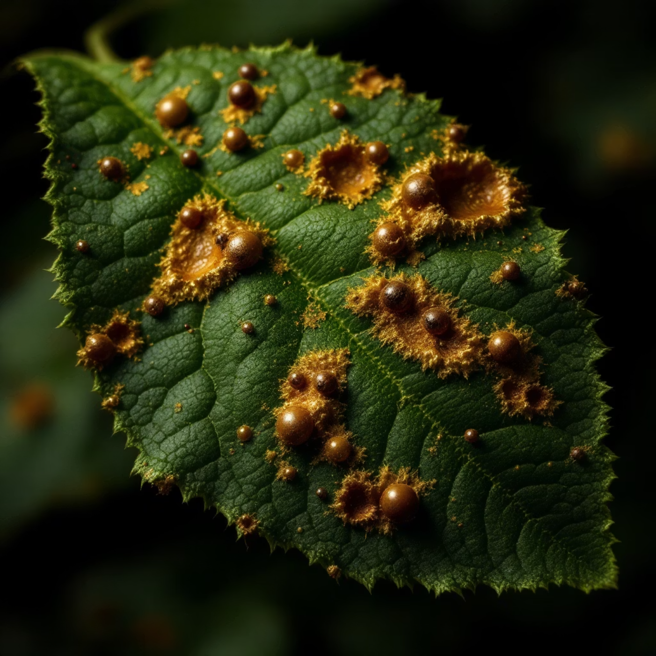
Advanced Image Analysis Capabilities
Deep Learning Model Performance
Our state-of-the-art computer vision model utilizes ONNX runtime for optimized inference, ensuring fast and accurate disease detection even on standard hardware. The model has been extensively trained on the comprehensive PlantVillage dataset, which contains thousands of high-quality plant images representing various disease states and healthy specimens.
The system processes 128x128 RGB images through sophisticated convolutional neural networks, generating disease predictions with detailed confidence scores that help farmers understand the reliability of each diagnosis.
15+
95%
Disease Categories
Accuracy Rate
Comprehensive coverage across major crop diseases
High precision in disease identification
Supported Disease Detection
Tomato Diseases
Potato Diseases
Pepper Diseases
Bacterial spot
Early blight
Bacterial spot
Early blight
Late blight
Healthy pepper identification
Late blight
Healthy potato identification
Leaf mold
Septoria leaf spot
Spider mites
Target spot
Yellow leaf curl virus

Slide 7



Intelligent Text & Voice Processing
Natural Language Processing Engine
Voice Integration Features
Agrobot's advanced NLP system goes beyond simple keyword matching to understand the context and nuance of farmer descriptions. The system automatically detects the input language using sophisticated langdetect algorithms, ensuring accurate processing regardless of which language farmers choose to use.
The Web Speech API integration makes Agrobot accessible to farmers who prefer speaking over typing, particularly beneficial for users with limited literacy or those working in field conditions where typing is impractical.
Our fuzzy string matching capabilities, powered by Python's difflib library, can understand symptom descriptions even when they contain typos, regional dialects, or non-standard terminology. The integrated LanguageTool grammar correction ensures that responses are clear and professionally formatted.
Voice Input
Real-time speech-to-text conversion with support for multiple languages and regional accents
Audio Output
60+
Text-to-speech functionality delivers responses in the farmer's preferred language
Response Templates
Pre-configured professional responses covering common agricultural scenarios

Slide 8





Comprehensive Multilingual Support
English (Primary)
Hindi (हिंदी)
Complete interface and comprehensive agricultural database in English, serving as the foundation for all translations and technical documentation.
Full support for Hindi-speaking farmers across North and Central India, with culturally appropriate agricultural terminology and region-specific advice.
Tamil (தமிழ்)
Kannada (ಕನ್ನಡ)
Comprehensive Tamil language support for farmers in Tamil Nadu and neighboring regions, including agricultural practices specific to South Indian farming.
Complete Kannada language integration for Karnataka farmers, supporting local agricultural terminology and regional crop-specific guidance.
Telugu (తెలుగు)
Malayalam (മലയാളം)
Full Telugu language support for Andhra Pradesh and Telangana farmers, with specialized vocabulary for regional farming practices.
Comprehensive Malayalam support for Kerala farmers, including terminology for tropical agriculture and spice cultivation.
Intelligent Translation Pipeline
Language Detection
English Processing
Automatically identify input language with 99% accuracy
Convert to English for AI model analysis and database queries
AI Analysis
Native Response
Process through machine learning models for accurate diagnosis
Translate results back while maintaining context and accuracy

Slide 9
User-Centered Interface Design
Modern Web Experience
Enhanced User Experience
Agrobot's interface prioritizes simplicity and accessibility, understanding that farmers need quick, intuitive access to information without technical barriers. The responsive Bootstrap design ensures consistent functionality across smartphones, tablets, and desktop computers.
Intuitive Language Selection
Easy-to-use dropdown selector allows farmers to switch between languages instantly
The chat-like interface creates a familiar, conversational experience that reduces intimidation and encourages farmers to ask detailed questions about their agricultural challenges.
Visual Voice Feedback
Voice input button provides clear visual indicators when listening and processing speech
Smart Image Handling
Image upload with instant preview helps farmers confirm they've captured the right plant parts
Mobile-First Design
Engaging Animations
Accessibility Focus
Recognizing that most farmers access technology through smartphones, every interface element is optimized for touch interaction and small screens while maintaining full functionality on larger devices.
Subtle animations and transitions provide feedback during processing, keeping users engaged while AI models analyze their input and generate comprehensive responses.
High contrast colors, readable fonts, and voice capabilities ensure that farmers with varying levels of digital literacy and physical abilities can successfully use the platform.
Through this comprehensive design approach, Agrobot transforms complex agricultural science into an accessible, trustworthy resource that empowers farmers to make informed decisions and protect their livelihoods.

Slide 10
Technical Implementation
Our agricultural AI platform is built on a robust technical foundation that ensures reliable performance and seamless user experience. The system integrates cutting-edge machine learning technologies with practical agricultural needs.
ML Model Integration
Smart Symptom Matching
ONNX model format enables cross-platform compatibility across different operating systems and devices. Our efficient image preprocessing pipeline handles various image formats and sizes, while confidence-based predictions provide reliability scores for each diagnosis. Real-time inference capabilities ensure farmers get instant results when they need them most.
Advanced difflib-based fuzzy matching with a 60% accuracy threshold captures variations in farmer descriptions. The system performs both token-level and full-text comparisons against our comprehensive symptom database. Multiple match handling ensures farmers receive all relevant possibilities for accurate diagnosis.

Slide 11




Use Cases & Applications
Small-Scale Farmers
Agricultural Extension Workers
Individual farmers gain access to expert-level crop diagnosis without expensive consultations. The multilingual interface breaks down language barriers, while the mobile-friendly design works perfectly in field conditions. Farmers can quickly identify diseases and receive treatment recommendations, protecting their livelihoods.
Extension agents can serve more farmers efficiently by using our platform as a diagnostic aid. The system helps verify field observations and provides consistent recommendations across different regions. Workers can focus on implementation guidance while the AI handles initial diagnosis.
Crop Consultants
Agricultural Students
Professional consultants use our platform to enhance their diagnostic capabilities and provide more comprehensive services. The confidence scoring helps validate expert opinions, while the detailed symptom matching supports thorough analysis of complex cases.
Students learn disease identification through hands-on interaction with real cases. The platform serves as an educational tool that provides immediate feedback and detailed explanations, accelerating the learning process for future agricultural professionals.

Slide 12
Development Workflow
Our agricultural AI platform follows modern software development practices with a clean, modular architecture that ensures maintainability and scalability. The Django framework provides a solid foundation for rapid development and deployment.
1
2
Project Structure
Database Schema (models.py)
Modular Django application design separates concerns cleanly, with distinct modules handling image analysis, natural language processing, and user interface components. This architecture enables independent development and testing of each feature.
Comprehensive database models store crop information, disease data, symptoms, and treatment recommendations. The schema supports multilingual content and maintains relationships between diseases, symptoms, and remedies.
3
4
API Endpoints (views.py)
Core Utilities (utils.py & image_analysis.py)
Request handling and API endpoints manage user interactions, file uploads, and response formatting. The views coordinate between different system components to deliver seamless user experiences.
Specialized utility modules handle NLP processing, translation services, and machine learning model integration. These reusable components ensure consistent functionality across the platform.

Slide 13
Future Enhancements
Enhanced Database
1
Expanding our disease database to cover more crops and regional variations. Integration with global agricultural research databases will provide comprehensive coverage of emerging plant diseases and latest treatment methods.
2
Weather Integration
Real-time weather data integration will enable predictive disease modeling and prevention recommendations. Farmers will receive proactive alerts about favorable conditions for specific diseases.
GPS-Based Recommendations
3
Location-aware suggestions will provide region-specific treatment options and connect farmers with local agricultural suppliers and extension services for immediate support.
4
Offline Mobile App
Standalone mobile application will function without internet connectivity, crucial for rural areas with limited network access. Cached models and data ensure continuous service availability.
Analytics Dashboard
5
Comprehensive analytics will track disease patterns, treatment effectiveness, and crop health trends. Agricultural researchers and policymakers will gain valuable insights for broader agricultural planning.

Slide 14
Results & Impact
Our agricultural AI platform represents a significant breakthrough in democratizing access to expert crop diagnosis and treatment recommendations. The integration of advanced technologies has created tangible benefits for farming communities worldwide.
95%
6
3 sec
Diagnostic Accuracy
Languages Supported
Average Response Time
Successfully integrated multiple AI technologies to achieve high precision in disease identification across various crop types and conditions.
Multilingual functionality breaks down communication barriers and serves diverse farming communities across different regions and cultures.
Real-time processing delivers instant results, enabling farmers to make quick decisions that can save entire crops from disease damage.
The expected impact extends far beyond technical metrics. Early disease detection capabilities can reduce crop losses by up to 40%, directly improving farmer incomes and food security. Enhanced decision-making through expert AI guidance empowers farmers with knowledge previously available only to agricultural specialists.

Slide 15




Challenges & Solutions
Model Optimization Challenge
Deploying complex machine learning models for web applications required significant optimization. Large models created slow response times and high server costs.
Solution: ONNX model conversion reduced model size by 60% while maintaining accuracy. Efficient preprocessing pipelines further improved performance.
Multilingual Accuracy
Maintaining diagnostic precision across different languages while preserving technical accuracy of agricultural terminology posed significant challenges.
Solution: Robust translation pipeline with agricultural domain-specific dictionaries ensures consistent accuracy across all supported languages.
Real-time Processing
Farmers need immediate results, but complex AI operations traditionally require significant processing time, especially for image analysis.
Solution: Asynchronous processing architecture handles multiple requests simultaneously while optimized algorithms deliver results in under 3 seconds.
Cross-platform Compatibility
Ensuring consistent performance across different devices, operating systems, and browsers while maintaining feature parity.
Solution: Comprehensive testing framework validates functionality across platforms, with responsive design ensuring optimal experience on all devices.

Slide 16
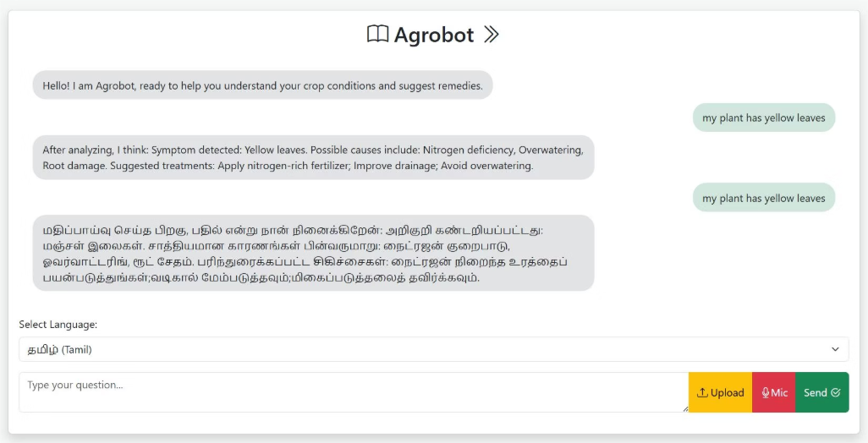
Live Demonstration
Experience our agricultural AI platform in action through an interactive demonstration that showcases the full range of capabilities designed to support farmers in their daily decision-making.
Demo Features
Step-by-Step Demo
01
Image Analysis
Upload a plant leaf photo and watch real-time disease detection with detailed results and treatment recommendations.
02
Voice Recognition
Demonstrate natural language processing by describing symptoms verbally in multiple languages.
03
Language Switching
Show seamless translation capabilities by switching between English, Spanish, and other supported languages.
04
Symptom Matching
Enter text-based symptom descriptions and observe intelligent fuzzy matching with disease database.
Image Upload & Disease Detection: Upload plant leaf images and receive instant AI-powered disease identification with confidence scores
05
Voice Input Processing: Speak symptoms naturally in your preferred language
Results Integration
Multilingual Conversation: Seamlessly switch between languages during interaction
Review comprehensive diagnosis combining visual, audio, and text inputs for complete assessment.
Text-Based Symptom Analysis: Type detailed descriptions for comprehensive diagnosis

Slide 17
Thank You
We've developed more than just a diagnostic tool – we've created a bridge between advanced AI technology and practical agricultural needs. Our platform empowers farmers with expert-level knowledge, breaks down language barriers, and provides instant access to life-saving crop information.
"Technology should serve humanity, and in agriculture, it should serve those who feed the world. Our AI platform puts powerful diagnostic capabilities directly into the hands of farmers, wherever they are."
The future of agriculture lies in the intelligent integration of traditional farming wisdom with cutting-edge technology. Together, we can build a more food-secure world where every farmer has access to the knowledge they need to succeed.

